Slide 1
SQL PROJECT ON TV SHOW ANALYSIS

Slide 2
INTRODUCTION
This TV shows dataset provides a comprehensive overview of 182
TV shows, including their key attributes such as ratings ,genres ,release
year, directors, and more. It is designed to facilitate in-depth
analysis of trends and patterns in the TV Show industry over multiple
years. The dataset combines user-generated metrics like IMDb-style
ratings offering a balanced perspective on each movie's reception.

Slide 3
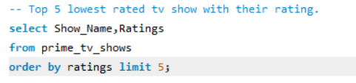
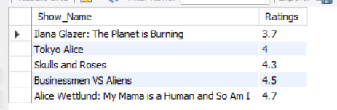
TOP 5 LOWEST RATED TV SHOW WITH RATING

Slide 4
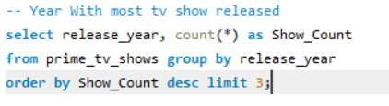
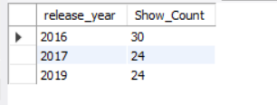
YEAR WITH MOST TV SHOW RELEASED

Slide 5
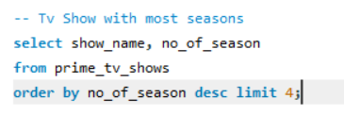
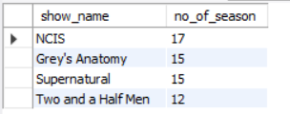
TV SHOW WITH MOST SEASON

Slide 6
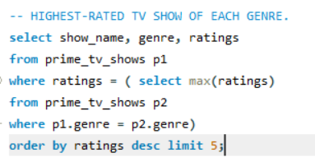
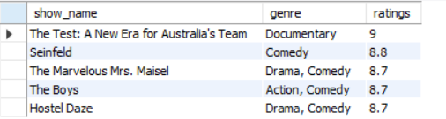
HIGHEST-RATED TV SHOW OF EACH GENRE.

Slide 7
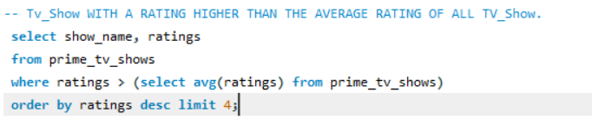
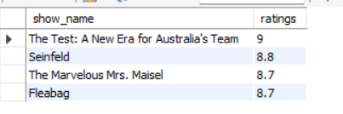
TV_SHOW WITH RATING HIGHER THAN AVGRAGE RATING OF ALL TV SHOW

Slide 8
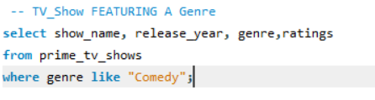
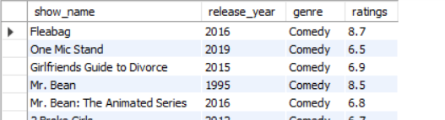
TV SHOW FEATURING A GENRE

Slide 9
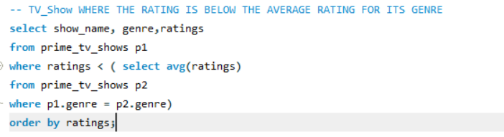
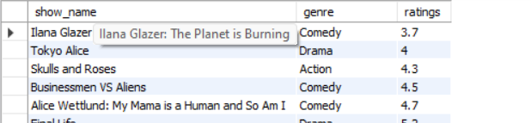
TV SHOW WHERE THE RATING IS BELOW THE AVERAGE RATING FOR ITS GENRE

Slide 10
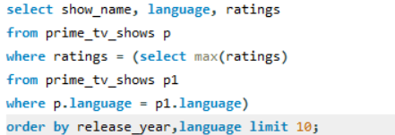
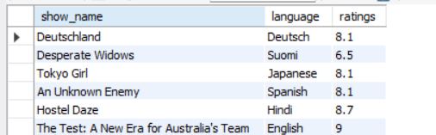
TOP-RATED TV SHOW FOR EACH LANGUAGE

Slide 11
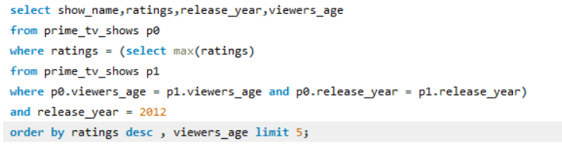
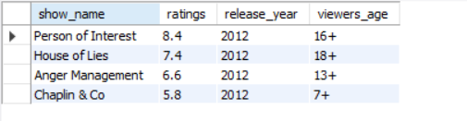
TV SHOW RELEASED IN 2012 THAT HAVE THE HIGHEST RATING FOR EACH VIEWERS AGE

Slide 12
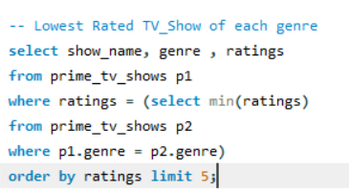
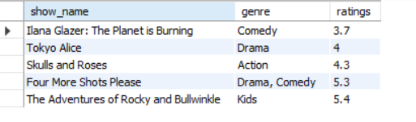
LOWEST RATED TV SHOW OF EACH GENRE

Slide 13
KEY INSIGHTS
The lowest rated tv show is Ilana Glazer
Most TV Show were released in 2016.
NCIS has most season in history of TV Shows.
The Best TV Show is “The Test” with rating of 9.
According to Viewers Age , the highest rated TV Show is “Person of Interest” with rating 8.4.

